Slide 1
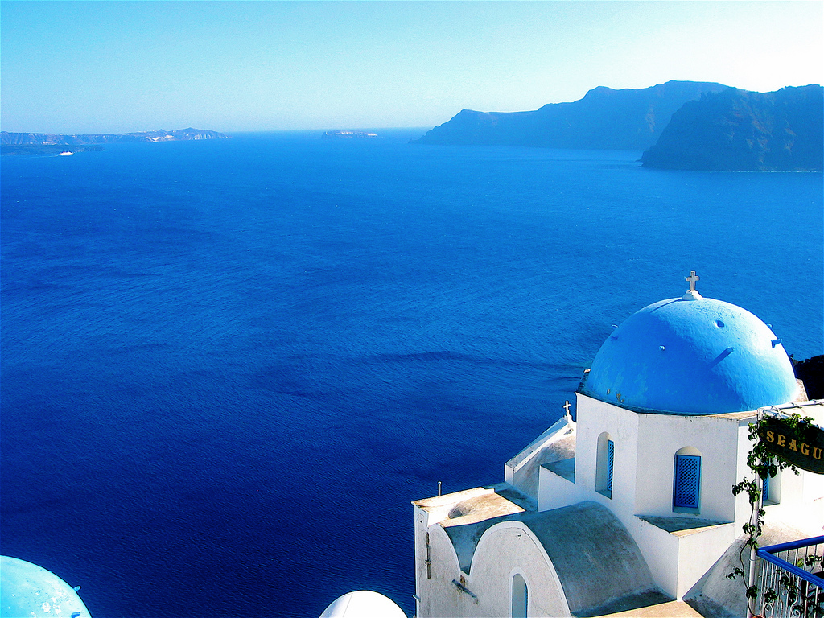
Lifting the Curse of
Coordination in Parallel ML
Dimitris Papailiopoulos
AMPLab UC Berkeley
Joint work with:
Xinghao Pan, Stephen Tu, Ben Recht
Kannan Ramchandran
Michael I. Jordan

Slide 2
is a framework for Parallelelizing ML algorithms
- Lock-free
- Asynchronous
- No memory contention
- Serializable
- Access Locality
- One analysis fits all
(SGD, SCD, RK, PCA, … even Cor. Clustering)
Like HOGWILD!
Unlike HOGWILD!

Slide 3
Motivating Applications

Slide 4









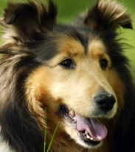
Classification

Slide 5
Classification
Feature space

Slide 6
Classification
Feature space
Train the best pair-wise classifier (SVM)

Slide 7
Classification
Feature space
Train the best pair-wise classifier (SVM)

Slide 8

Topic Modeling
Why is it raining today? #sad
I love the rain <3
<3 this game #Go Warriors
Warriors are the best
Higher Taxes for Better Health Care? Thanks Obama!
Sanders for President
[Bittorf, Recht, Re, Tropp 2012]
[Arora et al 2012], [Gillis et al, 2012]

Slide 9
Topic Modeling
Why is it raining today? #sad
I love the rain <3
<3 this game #Go Warriors
Warriors are the best
Higher Taxes for Better Health Care? Thanks Obama!
Sanders for President
[Bittorf, Recht, Re, Tropp 2012]
[Arora et al 2012], [Gillis et al, 2012]

Slide 10
Topic Modeling
Topic 1
Why is it raining today? #sad
I love the rain <3
<3 this game #Go Warriors
Topic 2
Warriors are the best
Higher Taxes for Better Health Care? Thanks Obama!
Topic 3
Sanders for President

Slide 11


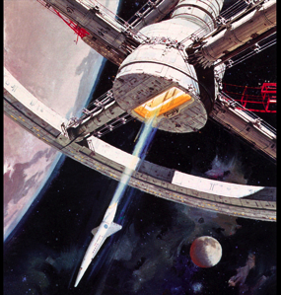




Product Recommendation

Slide 12
Product Recommendation
Topic Modeling
Classification
Feature space
All Solved by an
Über-algorithm
Why is it raining today? #sad
I love the rain <3
<3 this game #Go Warriors
The warrior are the best
PCA
Higher Taxes for Better Health Care? Thanks Obama!
Iterative Linear Solvers
Sanders for President
Graph Clustering

Slide 13
Stochastic Updates:
A Meta-algorithm

Slide 14
Stochastic Updates: the Über-algorithm
Data points
Model
1
2
2
3
4
Step1: Pick random data point

Slide 15
Stochastic Updates: the Über-algorithm
Data points
Model
1
2
3
4
Step 2:
Read Variables

Slide 16
Stochastic Updates: the Über-algorithm
Data points
Model
1
Compute a local function
2
3
4
*for inference, this would be the gradient of a loss
(like sum of squared diff)
Step3:
Compute local function

Slide 17
Stochastic Updates: the Über-algorithm
Data points
Model
1
Update Model
2
3
4
Step4:
Update Model

Slide 18
Stochastic Updates: the Über-algorithm
Data points
Model
Read variables
1
2
3
4

Slide 19
Stochastic Updates: the Über-algorithm
Data points
Model
Compute a local function
1
2
3
4

Slide 20
Stochastic Updates: the Über-algorithm
Data points
Model
Compute a local function
1
2
3
4

Slide 21
Stochastic Updates: the Über-algorithm
Comes with Different Names and in different flavors
ML / cvx opt / statistics
Stochastic Gradient, Incremental Grad. Descent, Rand. Coordinate Desc. …
Nonconvex / Combinatorial opt
Allecton (PCA), KwikCluster (Graph Clustering), …
Has been around since forever
For a reason
Data points
Model
Update Model
1
2
3
4

Slide 22
Stochastic Updates: the Über-algorithm
Suitable for
A lot of different problems
Convex, nonconvex, combinatorial
Goal: Parallelize this

Slide 23
Is Stochastic Updates “Embarrassingly Parallel”?

Slide 24
Parallel Stochastic Updates
Data points
variables
Say, I run parallel Updates.
If there is no conflict… I’m good.

Slide 25
Parallel Stochastic Updates
Data points
variables
Point1:
Avoiding Conflicts
Can be really slow
But serializable
no mem conflicts
Point2:
HOGWILD! Updates can be really fast
but can be messy
+ mem. conflicts
Say, I run parallel Updates.
If there is conflict… ??
Approach 1: Coordinate updates (Concurrency control)
Approach 2: Don’t Care (HOGWILD!)

Slide 26
A framework
to parallelize Stochastic Updates

Slide 27
A graph view of Conflicts

Slide 28
The Data-point Conflict Graph
Data points
Model
1
2
n
1
2
n
An edge between 2 updates if they overlap

Slide 29
The Theorem
[Krivelevich’14]
= the maximum Degree
1
2
1
2
1
2
sample
C.C.
n
n
n
Thm:
Sample vertices (with/without replacement)
Then, the induced sub-graph shatters in tiny pieces!
The largest connected component has size
Even if the Graph was a Single Huge Conflict Component!

Slide 30
Sample Batch + Connected Components
Phase 1
sample
C.C.
Sample data points
Compute Conn. Components
NOTE: No conflicts across groups!
Max Conn. Comp = logn => B / logn tiny components
Yay! Good for parallelization
No conflicts across groups = we can run Stochastic Updates on each of them in parallel!

Slide 31
Sample Batch + Connected Components
Phase 1
sample
C.C.
Allocation
Phase 1I
Core1
Core 2
Core p
Cores < Batch size / logn = n/(Δlogn)

Slide 32
Sample Batch + Connected Components
Phase 1
sample
C.C.
Allocation
Phase 1I
Core1
Core 2
Core p
A Single Rule: Run the updates serially inside each connected component
Automatically Satisfied since we give each conflict group to a single core.

Slide 33
Sample Batch + Connected Components
Phase 1
sample
C.C.
Allocation
Phase 1I
Core1
Core 2
Core p
Policy 1: Random allocation, good when cores << Batch size
Policy II: Greedy min-weight allocation
(80% as good as optimal (which is NP-hard))
A Single Rule: Run the updates serially inside each connected component
Automatically Satisfied since we give each conflict group to a single core.

Slide 34
Sample Batch + Connected Components
Phase 1
sample
C.C.
Allocation
Phase 1I
Core1
Core 2
Core p
Asynchronous and Lock-free Stochastic Updates
Phase III
SU
SU
SU
Core1
Core 2
Core p

Slide 35
Sample Batch + Connected Components
Phase 1
Each core runs Asynchronously
sample
C.C.
No Memory Locks & No Contention
Allocation
Phase 1I
Access Locality
Core1
Core 2
Core p
Minimal Communication
Read-write once on shared state / batch
Asynchronous and Lock-free Stochastic Updates
Phase III
SU
SU
SU
Core1
Core 2
Core p

Slide 36
Sample Batch + Connected Components
Phase 1
sample
C.C.
Allocation
Phase 1I
Core1
Core 2
Core p
Asynchronous and Lock-free Stochastic Updates
Phase III
SU
SU
SU
Core1
Core 2
Core p
Wait for Everyone to Finish

Slide 37
Sample Batch + Connected Components
Phase 1
sample
C.C.
Allocation
Phase 1I
Core1
Core 2
Core p
Asynchronous and Lock-free Stochastic Updates
This is as fast as it gets
Phase III
SU
SU
SU
Core1
Core 2
Core p
Wait for Everyone to Finish

Slide 38
If Phase I and II are fast
We are good.
Sample Batch + Connected Components
Phase 1
sample
C.C.
Allocation
Phase 1I
Core1
Core 2
Core p
Asynchronous and Lock-free Stochastic Updates
This is as fast as it gets
Phase III
SU
SU
SU
Core1
Core 2
Core p
Wait for Everyone to Finish

Slide 39
Sample Batch + Connected Components
Phase 1
Serial Cost:
sample
C.C.
Allocation
Phase 1I
Serial Cost:
Core1
Core 2
Core p
Asynchronous and Lock-free Stochastic Updates
Phase III
Serial Cost:
SU
SU
SU
Core1
Core 2
Core p
Wait for Everyone to Finish

Slide 40
Sample Batch + Connected Components
Phase I and II can be pipelined while Phase III is running
Phase 1
Serial Cost:
sample
C.C.
Allocation
Phase 1I
Serial Cost:
Core1
Core 2
Core p
Asynchronous and Lock-free Stochastic Updates
Phase III
SU
SU
SU
Core1
Core 2
Core p
Wait for Everyone to Finish

Slide 41
Sample Batch + Connected Components
Speedup
(in the worst case)
Identical performance as serial for
- SGD
- SCD
- Iterative Linear Solvers
- Stochastic PCA
- Greedy Clustering
Phase 1
sample
C.C.
Allocation
Phase 1I
Core1
Core 2
Core p
Asynchronous and Lock-free Stochastic Updates
Phase III
SU
SU
SU
Core1
Core 2
Core p
Wait for Everyone to Finish

Slide 42
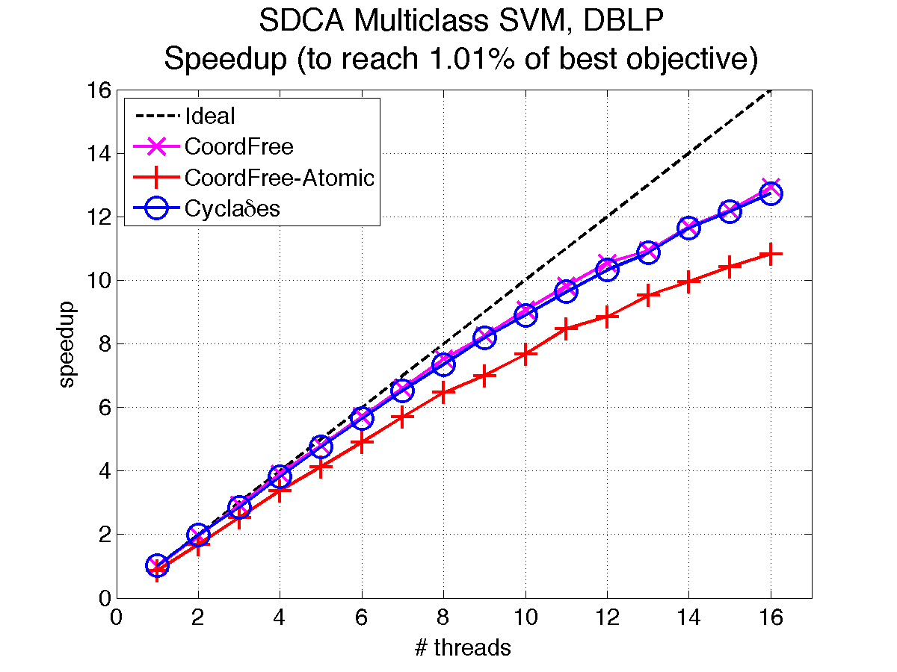
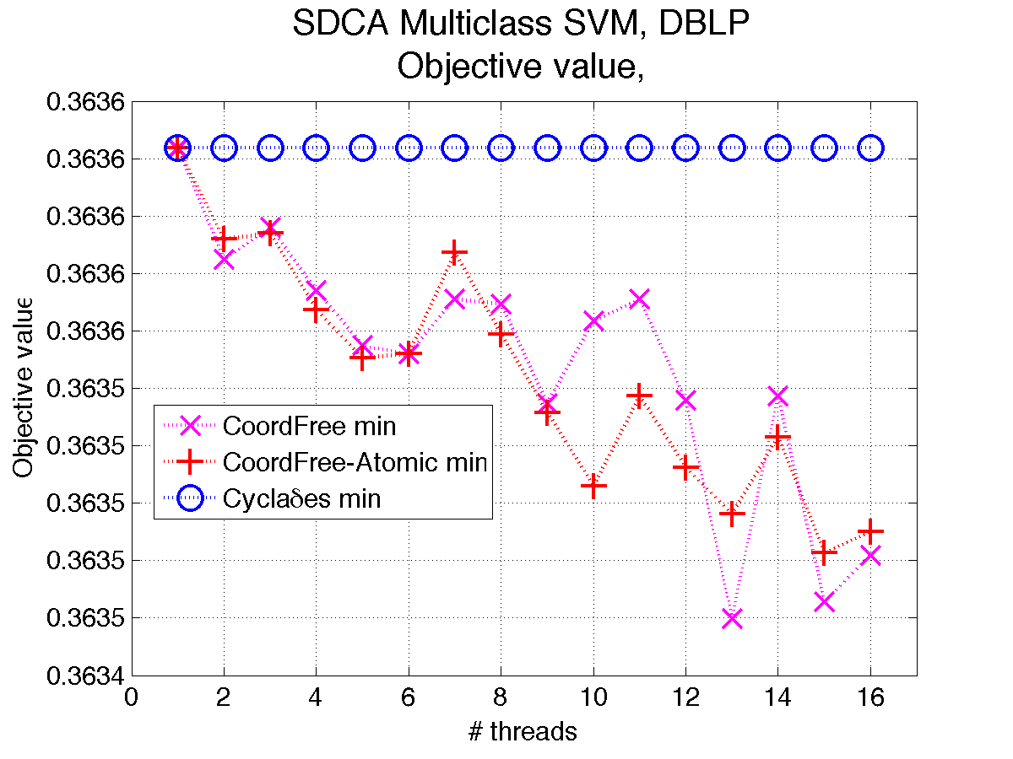
Preliminary Experiments:
Scala Implementation (2 cpus, 8 cores)
SDCA on multiclass SVM
synthetic data, nnz in features based on DBLP graph
317K features and samples, # classes = 1000
batch size = 1.5K

Slide 43
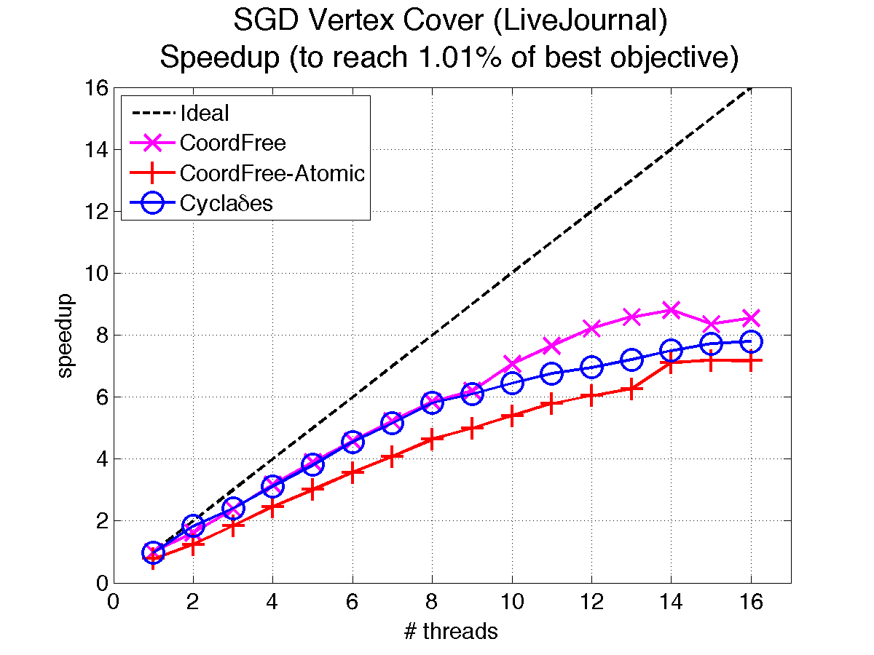
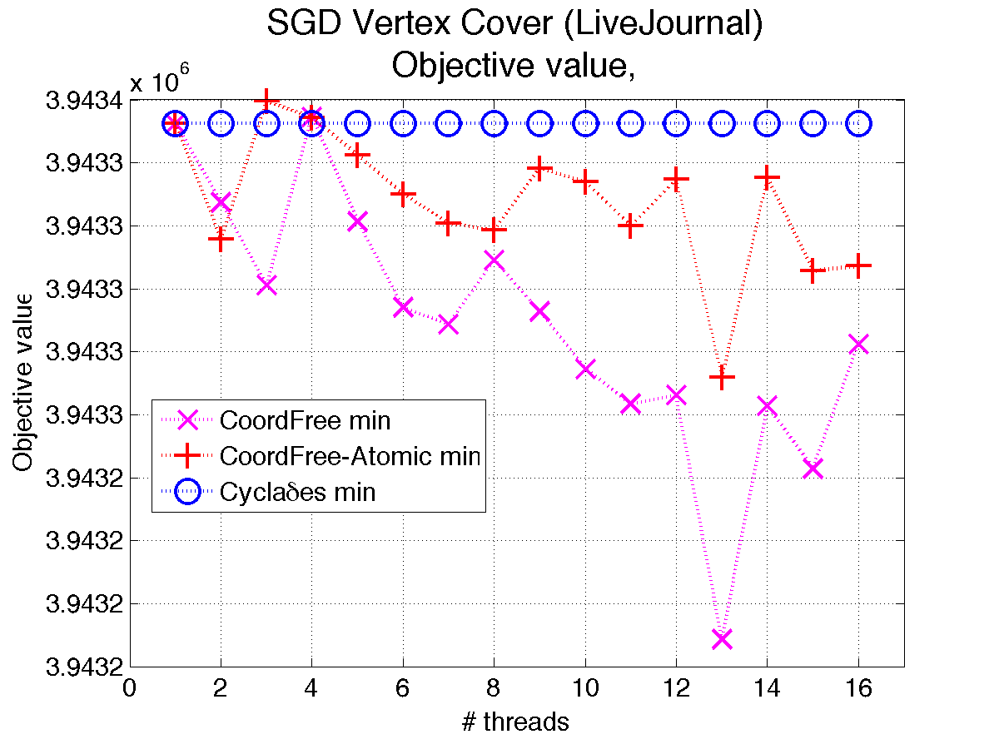
Preliminary Experiments:
Scala Implementation (2 cpus, 8 cores)
SG for Vertex cover
on the LiveJournal graph
35M edges 4M vertices
batch size =175K

Slide 44
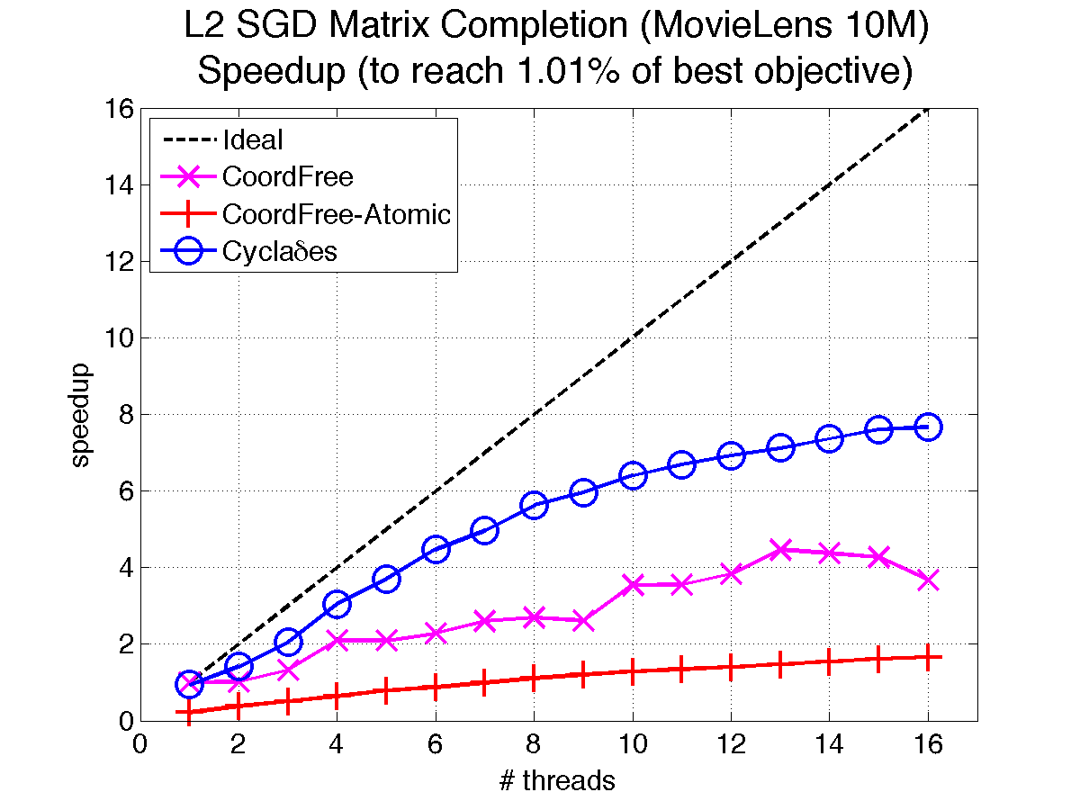
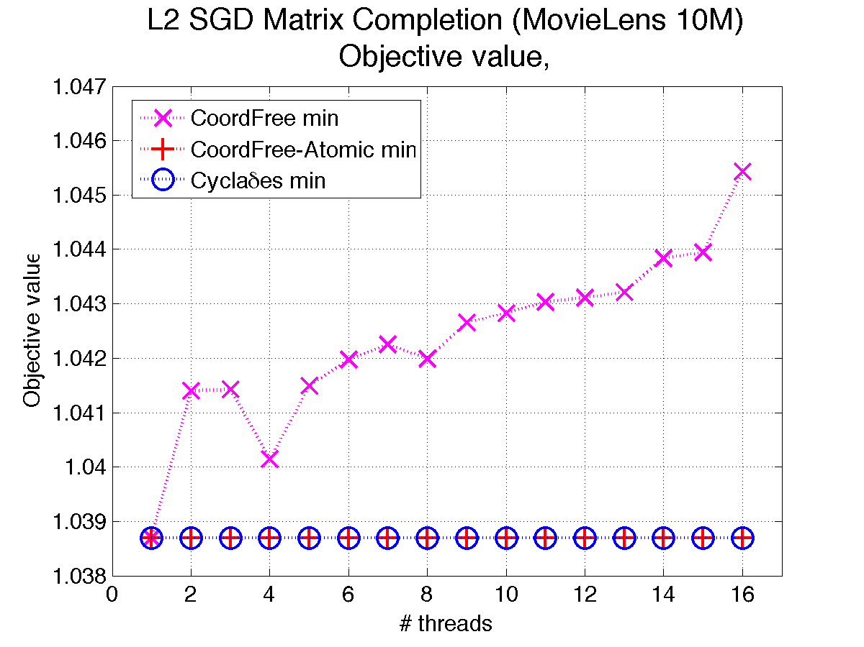
Preliminary Experiments:
Scala Implementation (2 cpus, 8 cores)
SG for matrix completion (+ book-keeping)
10M Movie Lens: 72K users, 10K movies
rank 10 decomposition
batch size is 5K

Slide 45
a framework for Parallel ML algorithms
- Lock-free
- Asynchronous
- No memory contention
- Completely Serializable
- One analysis fits all
(SGD, SCD, RK, PCA, … even Cor. Clustering)

Slide 46
Open Problems
Scala Cyclades competitive to HOGWILD!...
Can be faster if there is book-keeping… but not on vanilla SGD
- Data locality matters! can we exploit it? NUMA aware implementation
- Dense Data sets?
Sparsify dense graphs

